Slide 1

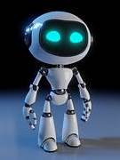
ESP32 CAM BASED SURVEILLANCE
ROBOT USING ARDUINO IDE
B. Charan Teja (2310040035)
U. Chaitanya (2310040007)
Anush Thak (2310040029)
Bhanu Praveen (2310049151)

Slide 2
ABSTRACT
This project presents the development of an ESP32 CAM-based surveillance robot designed for real-time monitoring and remote control. Utilizing the ESP32-CAM module, the robot captures high-quality video and streams it over Wi-Fi, allowing users to view the feed from any web browser. The robot is equipped with DC motors for movement, controlled via a mobile interface. Additional features include obstacle detection using ultrasonic sensors, enhancing its autonomous capabilities. This surveillance robot aims to provide a cost-effective and versatile solution for home security and monitoring applications, showcasing the potential of IoT technologies in robotics.

Slide 3
LITERATURE SURVEY
The development of surveillance robots has gained significant attention in recent years due to advancements in robotics, artificial intelligence, and Internet of Things (IoT) technologies.
Existing Surveillance Solutions: Traditional security systems often rely on fixed cameras, which lack mobility and flexibility. Recent studies highlight the benefits of using mobile platforms for surveillance, allowing for dynamic monitoring of environments.
ESP32 CAM Applications: The ESP32-CAM has emerged as a popular choice for IoT projects due to its low cost, integrated Wi-Fi, and camera capabilities. Previous research has demonstrated its effectiveness in remote surveillance applications, enabling users to stream video and control devices from a distance.
Comparative Studies: Comparisons between various microcontroller platforms (like Raspberry Pi and Arduino) reveal that the ESP32 offers a balanced combination of performance, ease of use, and power efficiency, making it suitable for battery-operated devices.
Obstacle Detection in Robotics: Literature on mobile robots emphasizes the importance of obstacle avoidance. Ultrasonic sensors are commonly employed for this purpose, providing real-time feedback to prevent collisions and enhance navigational capabilities.
IoT Integration: The integration of surveillance systems with IoT frameworks has been explored extensively. Studies indicate that such systems can improve monitoring efficiency and provide valuable data analytics, enhancing security measures.

Slide 4
METHODOLOGY :
The development of the ESP32 CAM-based surveillance robot follows a systematic approach, consisting of several key stages:
Component Selection:
ESP32-CAM Module: Chosen for its built-in camera and Wi-Fi capabilities.
Chassis and Motors: A suitable robot chassis is selected, equipped with DC motors for mobility.
Motor Driver: An L293D motor driver is used to control the motors.
Power Supply: A battery pack is selected to ensure portability.
Sensors: Ultrasonic sensors are integrated for obstacle detection.
Hardware Assembly:
The chassis is assembled, and the ESP32-CAM is securely mounted.
Connections are made between the ESP32, motor driver, motors, and sensors, following a predefined circuit diagram to ensure proper functionality.
Software Development:
The Arduino IDE is used for coding the ESP32. Key functionalities include:
Camera Initialization: Setting up the camera for video streaming.
Wi-Fi Configuration: Connecting the ESP32 to a local network for remote access.

Slide 5
4.Testing and Calibration:
The camera stream is tested to ensure proper functionality.
Motor movements are calibrated to verify responsiveness and control accuracy.
Ultrasonic sensors are tested for accurate obstacle detection and avoidance.
5.Integration:
The complete system is integrated, allowing the robot to perform as a cohesive unit.
A comprehensive testing phase is conducted to evaluate performance in various scenarios, ensuring reliability and efficiency.
6.Final Adjustments:
Based on testing feedback, adjustments are made to the code and hardware as necessary to optimize performance.

Slide 6
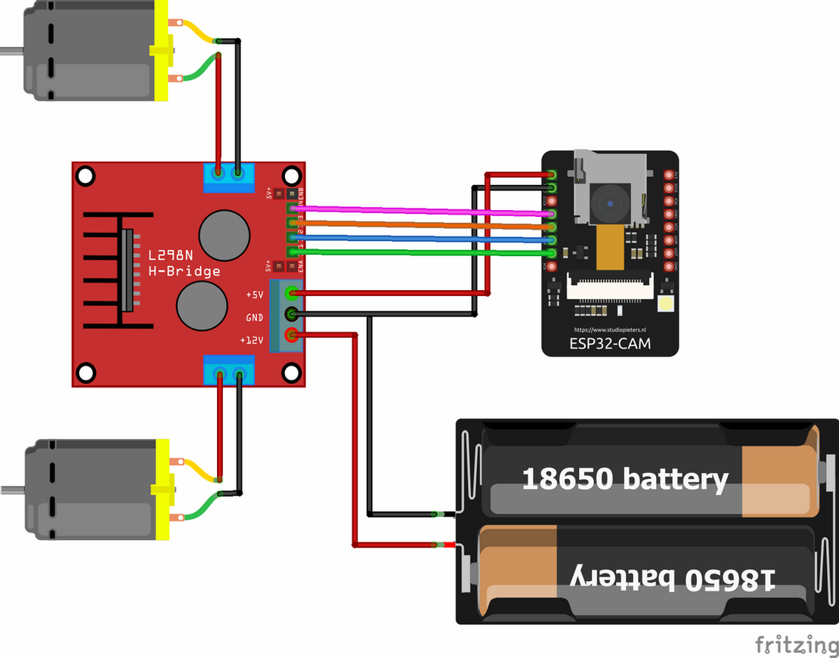
BLOCK DIAGRAM

Slide 7
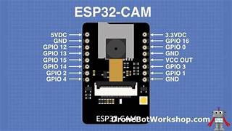
COMPONENTS
ESP32-CAM Module:
Description: A compact microcontroller with integrated Wi-Fi and Bluetooth capabilities, along with a camera for capturing images and streaming video.
Key Features:
2 MP camera with video streaming capabilities.
Supports various resolutions and frame rates.
GPIO pins for additional components.

Slide 8
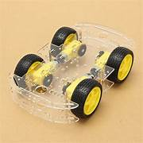
Robot Chassis:
Description: A physical structure that houses all components of the robot, typically made from plastic or metal.
Key Features:
Lightweight and durable design.
Includes space for mounting motors and the ESP32-CAM.

Slide 9
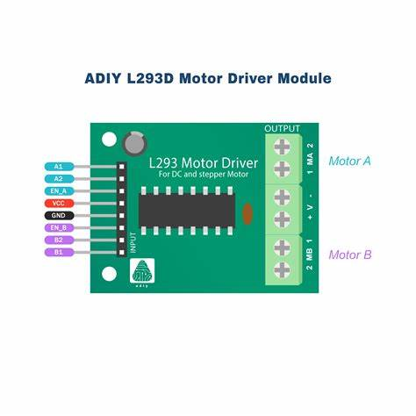
Motor Driver (L293D):
Description: An H-bridge motor driver that allows for the control of the speed and direction of DC motors.
Key Features:
Dual-channel operation for controlling two motors.
Can handle up to 2A per channel.

Slide 10
Included Libraries:
esp_camera.h
WiFi.h
esp_timer.h
img_converters.h
Arduino.h
fb_gfx.h
soc/soc.h
soc/rtc_cntl_reg.h
esp_http_server.h

Slide 11
OUTPUT
Live Video Streaming: Successfully streams video with minimal latency, accessible
via a local IP address.
Image Capture: Captures images upon command and stores them for review.
Motion Detection: Detects motion within a specified range, automatically triggering
the camera.
Performance Metrics: Frame rate of 10-15 fps, 3-hour battery life, and responsive to
motion within 1 second.

Slide 12
Applications
Home Security: Remote monitoring to detect unauthorized access.
Industrial Surveillance: Monitor restricted areas or machinery in real-time.
Agricultural Monitoring: Observe crop health or track animal activity.
Warehouse and Inventory Surveillance: Automated patrol for security in storage areas.
Educational Projects: Demonstrates IoT-based surveillance concepts and practical applications.

Slide 13
Advantages & Disadvantages
Advantages:
Cost-Effective: Affordable components make this a budget-friendly solution.
Remote Accessibility: View live feeds from anywhere within Wi-Fi range.
Scalable Design: Can add features like night vision or cloud integration.
Disadvantages:
Limited Battery Life: Higher power consumption during motor operation.
Wi-Fi Dependency: Requires stable Wi-Fi for continuous operation.
Limited Range: PIR sensor may miss movements beyond its 5-meter range.

Slide 14
Conclusion :
The ESP32 CAM-based surveillance robot is a cost-effective and scalable solution for security.
Future improvements could involve AI and autonomous patrol functions.
This project highlights the practicality of low-cost, IoT-based surveillance systems in diverse environments.

